Slide 1
Le meilleur article de tous les temps
Présentation par Michaël Rochoy
Médecin généraliste
(Conflit d’intérêt : engagé dans la lutte contre l’accidentologie trottinesque)

Slide 2
« Nous avons le droit d’être intelligents » (17 février)

Slide 3
« Nous voulons signer une décharge (et) être des cobayes » (29 mars)

Slide 4
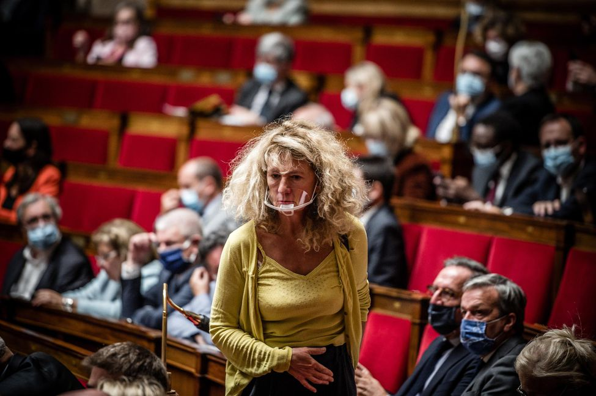
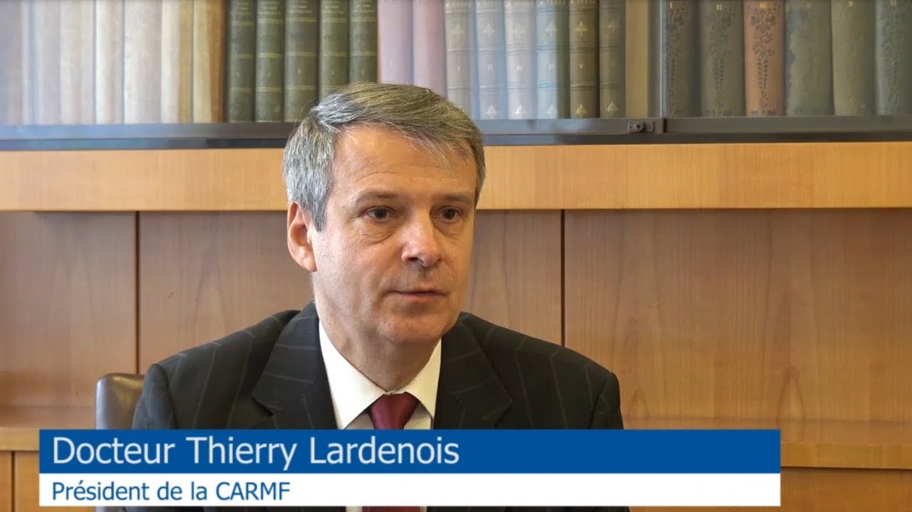
L’étude rétrospective qui n’est pas du tout un essai clinique sauvage, rien à voir (30 avril)

Slide 5
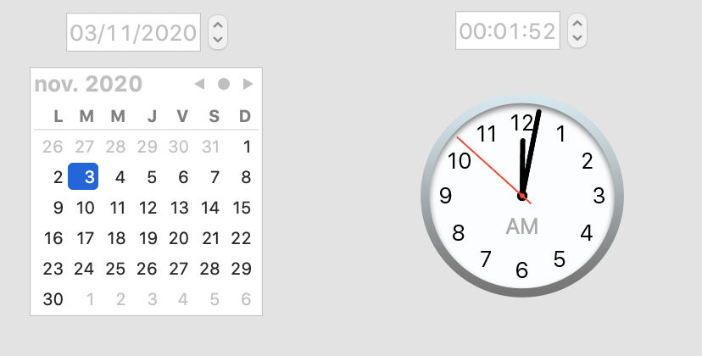
« Nous ne pouvons conduire l’étude compassionnelle »

Slide 6
Un collectif qui n’a rien contre un petit don

Slide 7
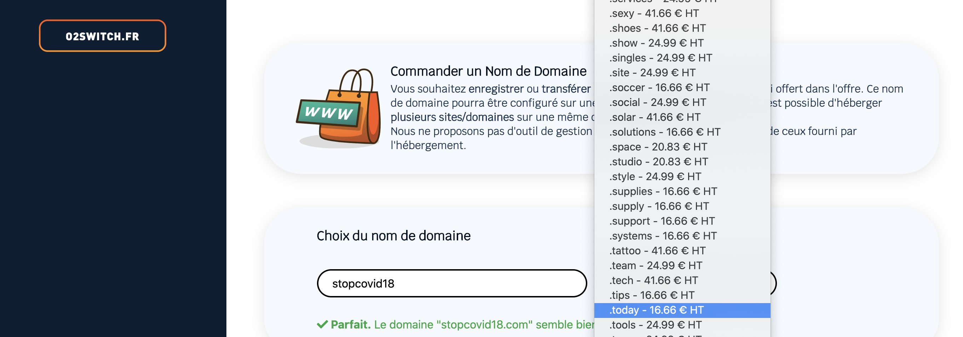
(Visiblement, il faut s’inquiéter pour la CARMF)

Slide 8
(A moins qu’ils n’aient pris l’offre star à 60€ HT/an pour 7 médecins ?)

Slide 9
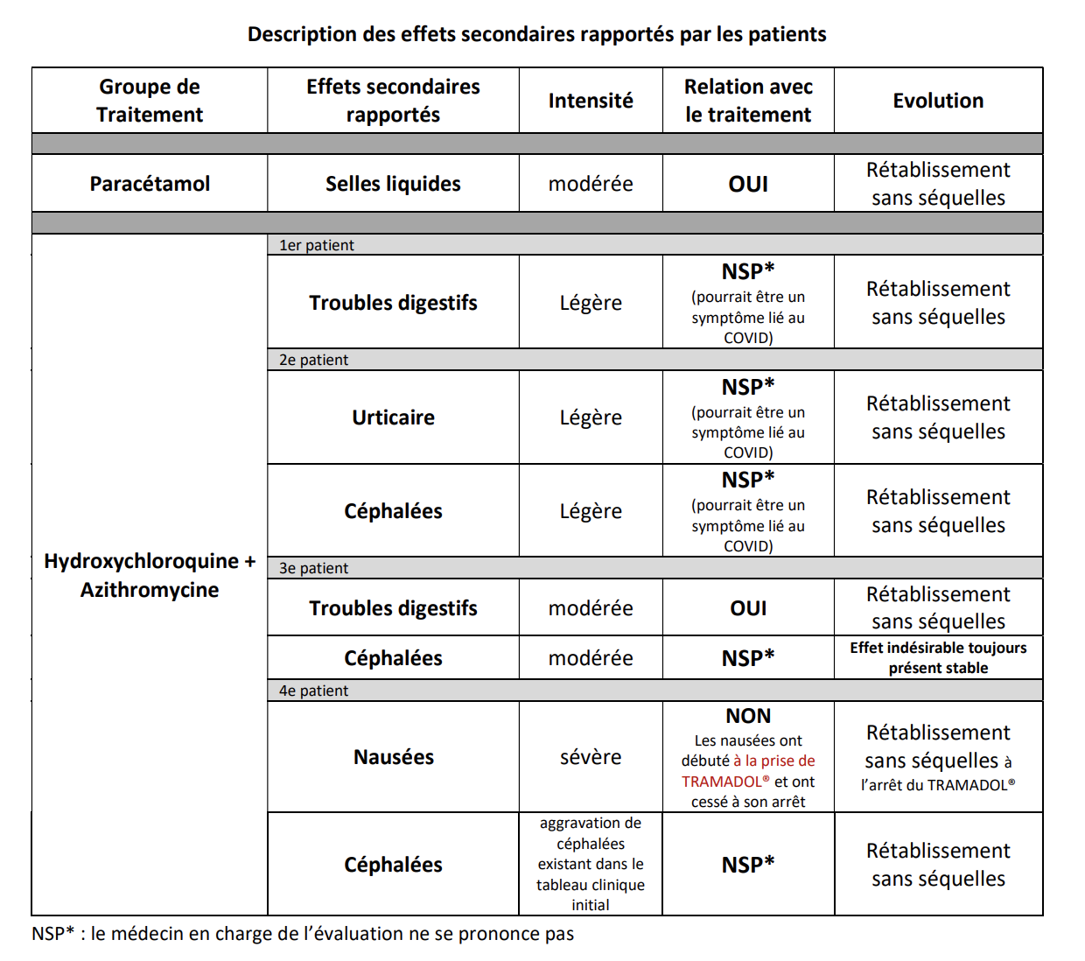
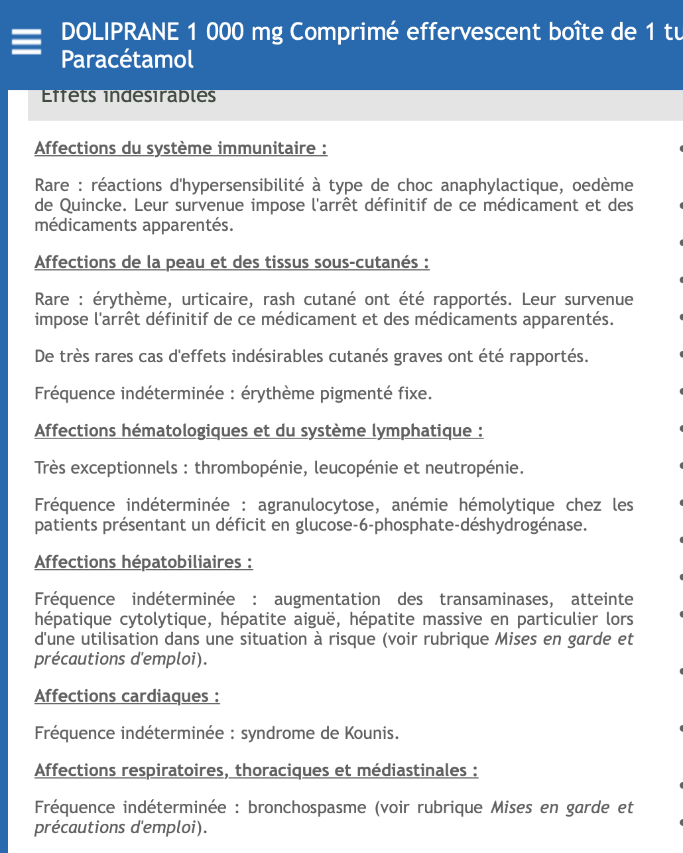
Une étude de grande qualité, avec des médecins totalement impartiaux

Slide 10
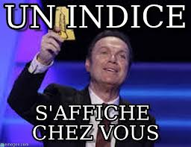

Slide 11
Une diffusion médiatique soutenue par France Soir, un blog complotiste

Slide 12
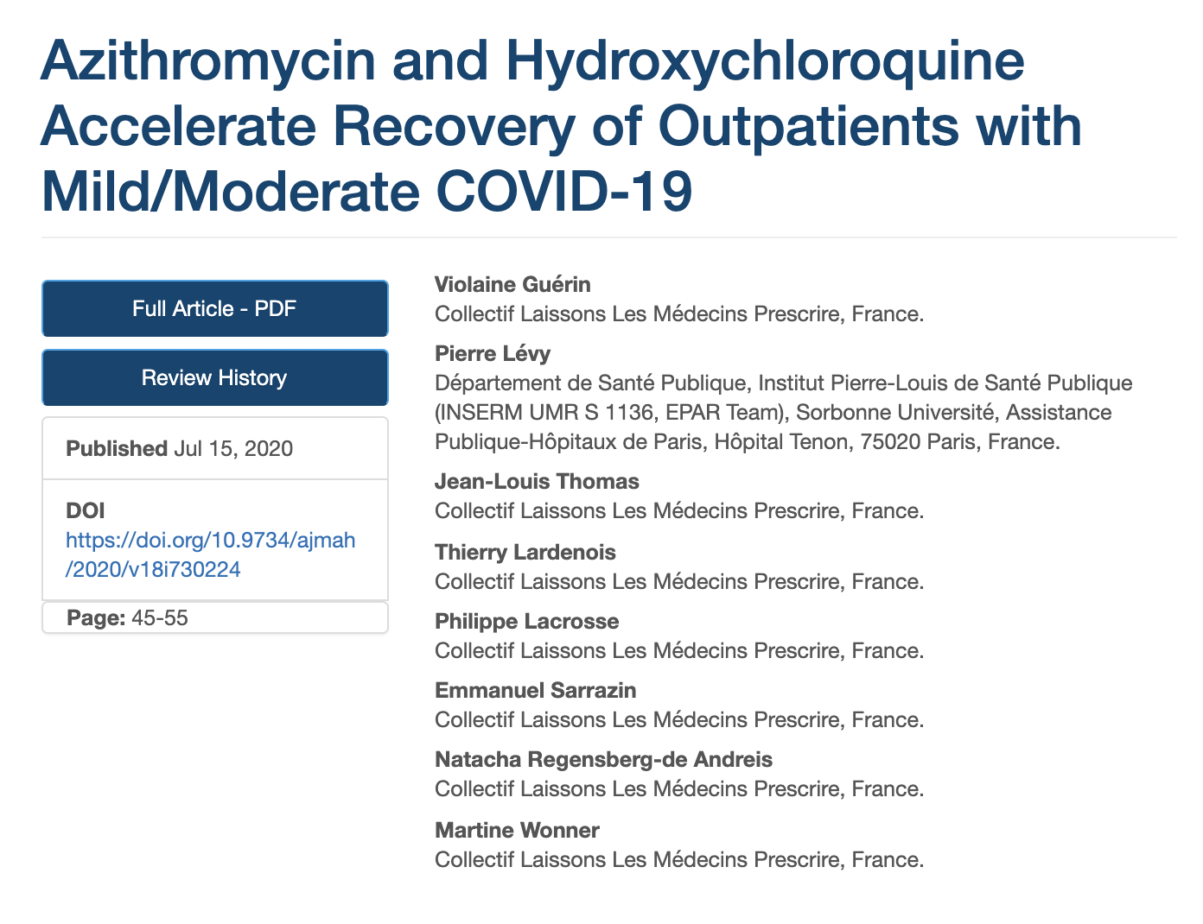
Tout ça retombait, quand soudain… (20 juillet)

Slide 13
(Tellement rétrospectif qu’un des 2 relecteurs a demandé des précisions sur le comité d’éthique…)

Slide 14
L’Asian Journal of Medicine and Health Une revue qui fait les soldes…

Slide 15
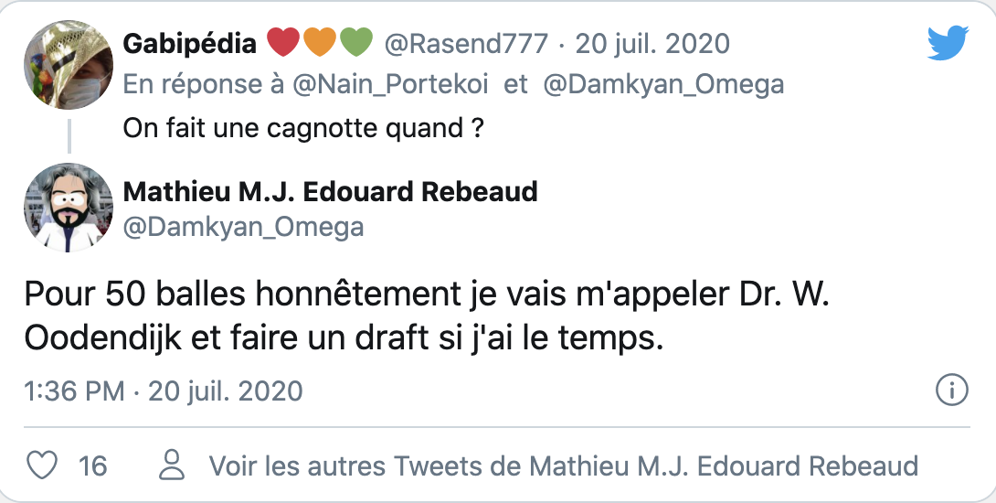
… et qui peut résister à ça ?

Slide 16
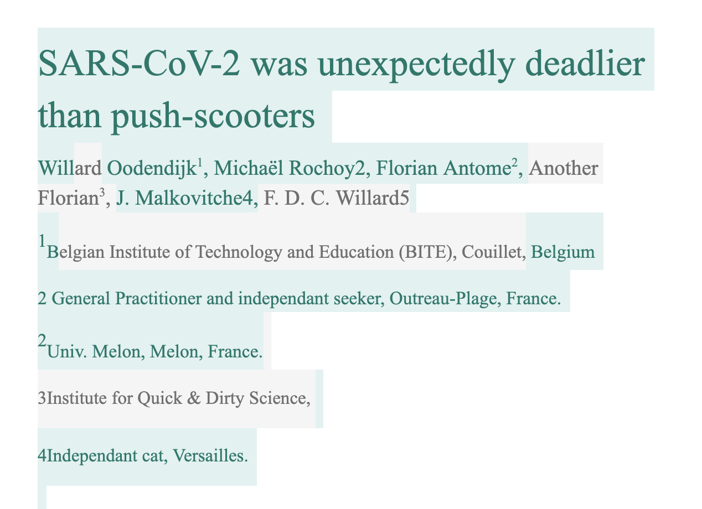
Création du groupe… et du Google Docs !

Slide 17
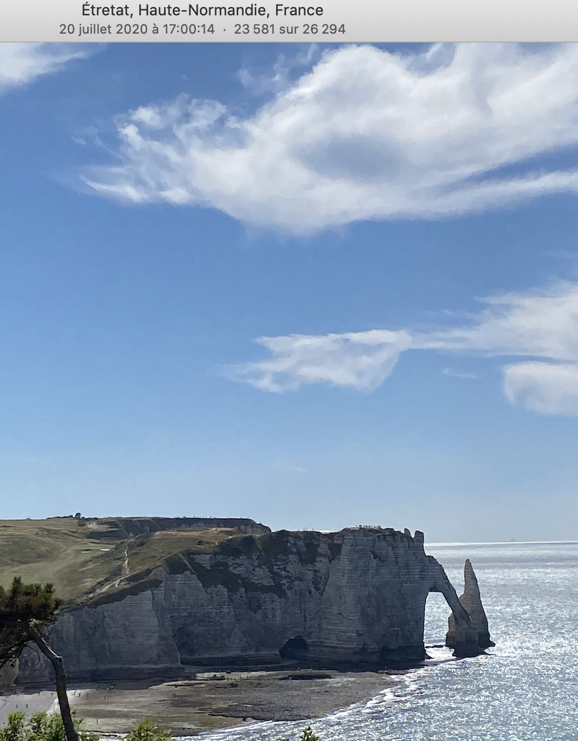
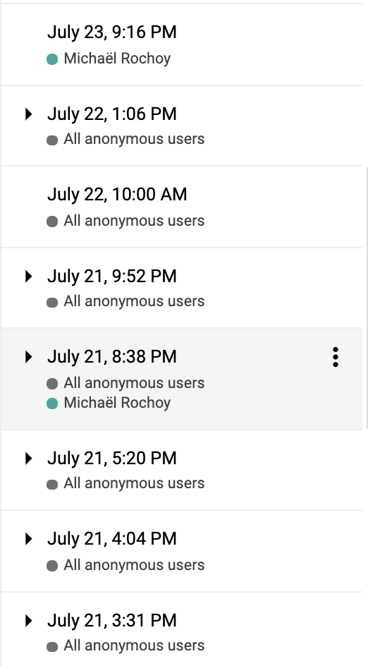
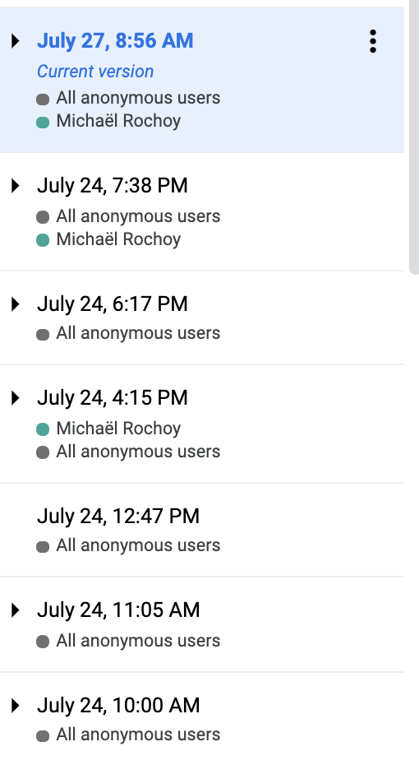
Une écriture « rapide » du 21 au 24 juillet

Slide 18
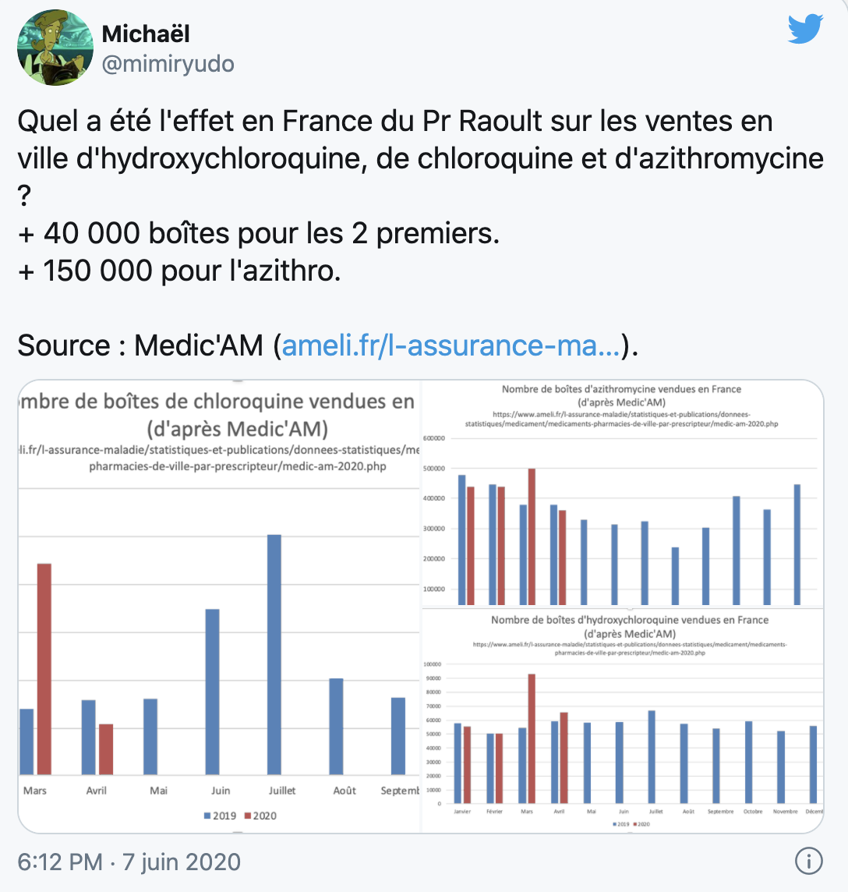
Exemple de la figure 1 et de l’étude 1…

Slide 19
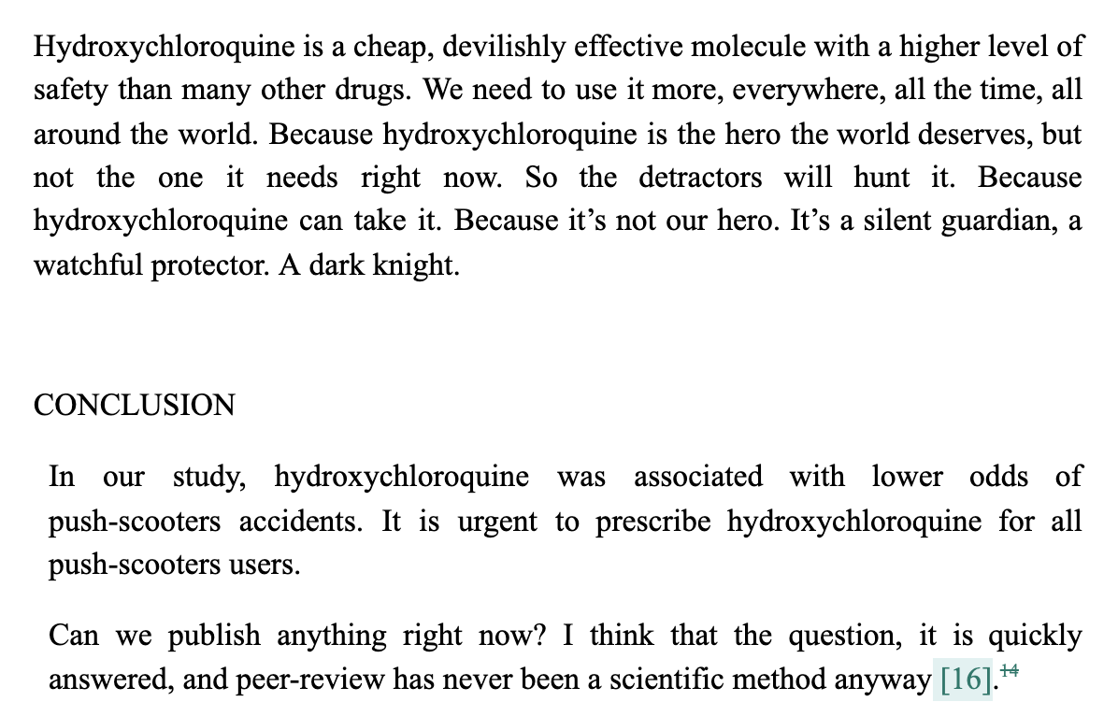
Soumission de l’article par « Wooden Dick » le vendredi 24 juillet au soir…
Option 1 : Aucune relecture et ça passe…
Option 2 : Une relecture et c’est fichu (nous n’avons soumis qu’ici !)

Slide 20
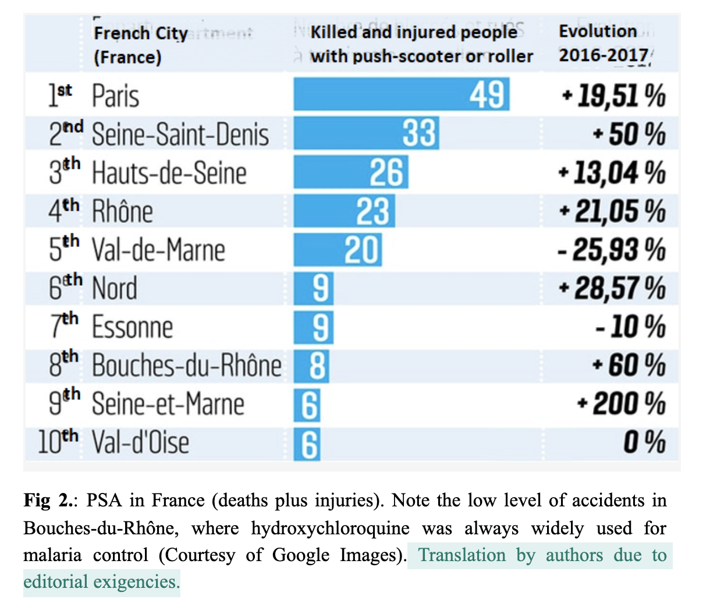
Lundi 27 juillet matin : « merci de traduire les figures » (un travail de pro de Valentin)

Slide 21
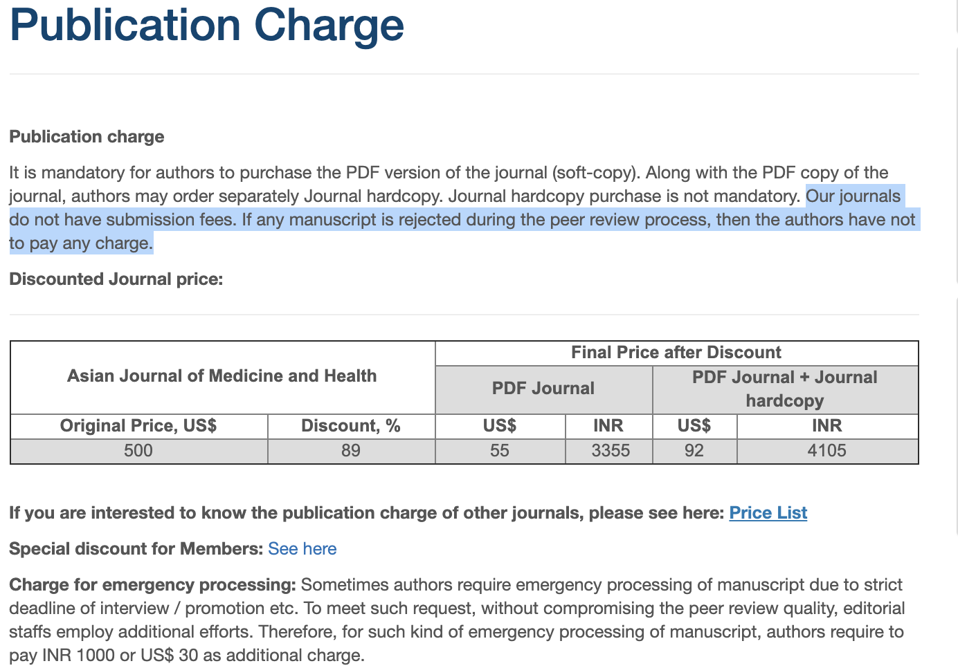
Mardi 28 juillet : à la caisse (85$ ou 77€, juste après une commande de pizzas…)

Slide 22
Lundi 3 août… « révisions mineures »
Des gens ont relu (3 reviewers !)
MAIS ont accepté la publication sous réserve de corrections
Qu’ils considèrent mineures

Slide 24
Je me charge des réponses aux reviewers le 3 août dans la journée…

Slide 25
« In Study 3 Wikipedia is not a reliable source for scientific research » (Reviewer 2)

Slide 26
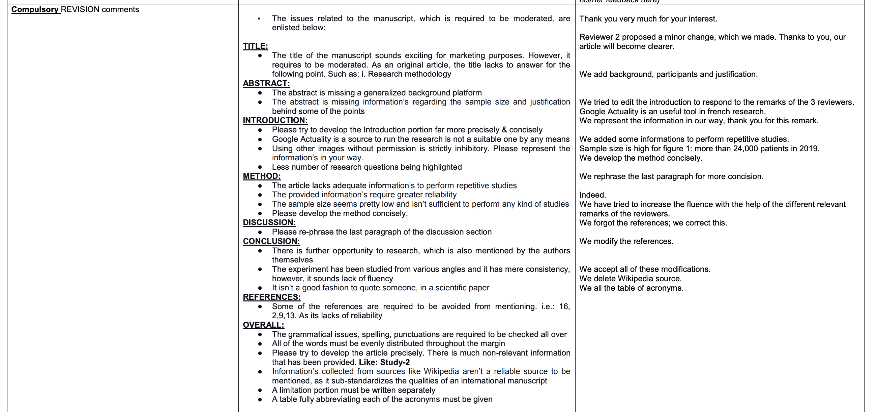
« Informations collected from sources like Wikipedia aren’t a reliable source to be mentioned, as it sub-standardizes the qualities of an international manuscript » (Reviewer 3)

Slide 27
Le 4 août : nous sommes en révisions finales !

Slide 28
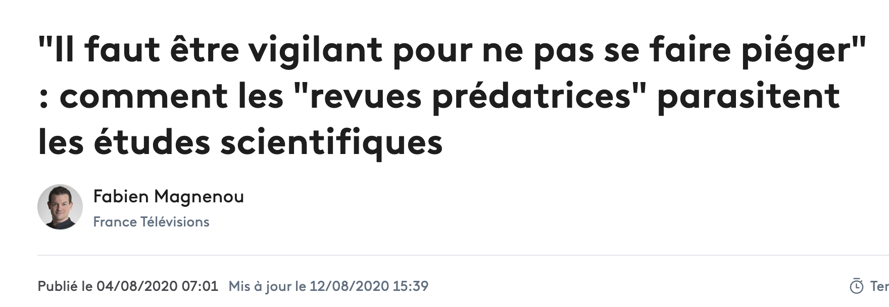
Dans son univers parallèle, le 4 août, Martine Wonner compare l’AJMH et le Lancet…

Slide 29
Le 6 août : les éditeurs s’en mêlent…
Le premier veut éclaircir ce point :

Slide 30
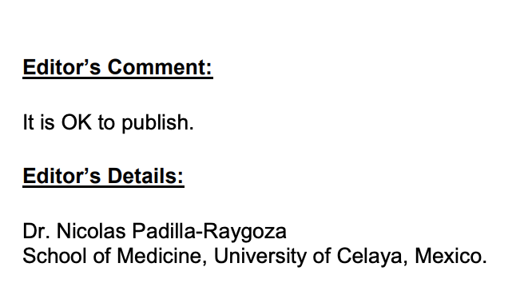
Le 8 août, le même insiste : il est lui-même Président d’un comité d’éthique (…)

Slide 31
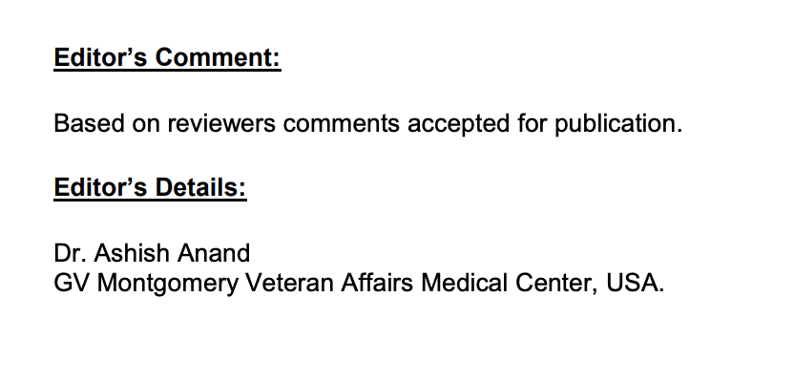
Le 2ème demande le rejet… nous n’aurons jamais son avis (disponible le 17 août sur le site) (Le 3ème s’en fiche).

Slide 32
Le mercredi 12 août (J19 – comme l’article de Violaine Guérin), l’article est accepté
Il faut encore valider les noms et affiliations et les participations des auteurs
Ca n’a jamais changé… mais nous leur remettons en première page surligné en jaune
Et le samedi 15 août…

Slide 34
L’article reste en ligne du 15 août 13h30 au 16 août à 18h… avant d’être rétracté en 28h !

Slide 35
L’article était « protégé » sur ResearchGate… et traduit dès J1 par Robin Allais

Slide 36
Un soutien (quasi) unanime de tous les chercheurs, des mails, commentaires, tweets… et la presse
Telegraph India Online (17 août) – a prévenu l’éditeur de la revue
France Info (17 août)
Le Parisien (17 août)
La Croix (18 août)
France 3 Hauts-de-France (18 août), repris sur France 3 National au 12h/13h (19 août)
La Voix du Nord (19 août)
Le Figaro (18 août)
RTBF (17 août)
RTS (22 août)
Europe 1 (17 août)
Radio Canada (17 août)
Ouest France (17 août)
L’Express (17 août)
L’Info de la Réunion (17 août)
Ebene Magazine (17 août)
Financial Afrik (17 août)
Leral TV (Sénégal) (17 août)
RTL (17 août)
Le site BFMTV (17 août)
Valeurs actuelles (17 août)
Sud Ouest (18 août)
Heidi News (18 août)
Capital (18 août)
La Libre (Belgique) (18 août)
Folha de San Paulo (Brésil) (18 août)
Le Temps (Suisse, 18 août), repris dans le Courrier International (23 août)
Sciences Avenir (19 août)
France Inter : revue de presse (19 août)
La Côte (19 août)
CNEWS (19 août)
TDG (19 août)
Ohlar Digital (Brésil) (19 août)
Tekniikan Maailma (Finlande) (20 août)
Egora (21 août)
MarseilleNews (21 août)
Causeur (22 août)
Hypeness (Brésil) (25 août)
Le Canard Enchaîné (26 août – tweet)

Slide 37
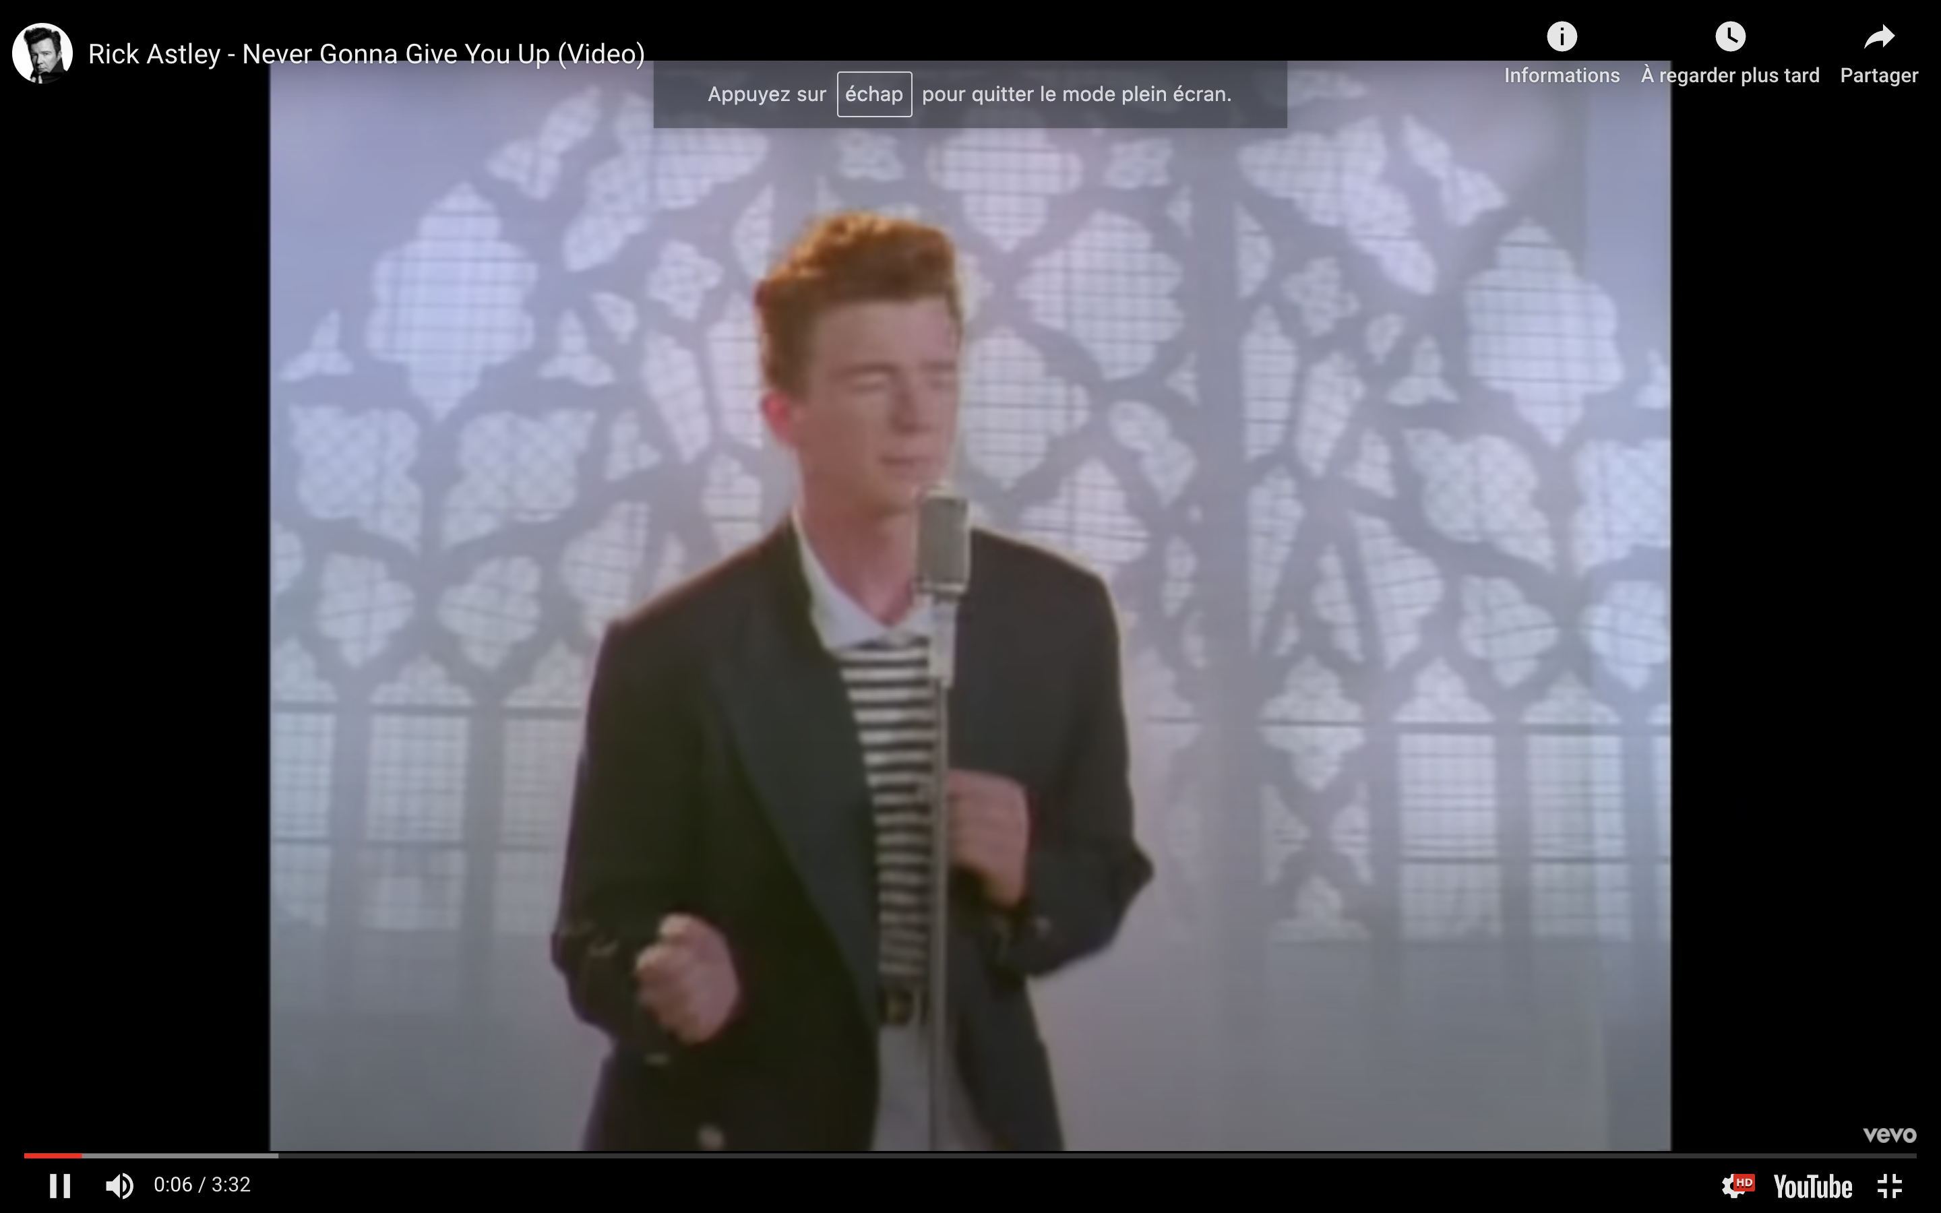
RT France et France Soir nous ont contacté

Slide 38
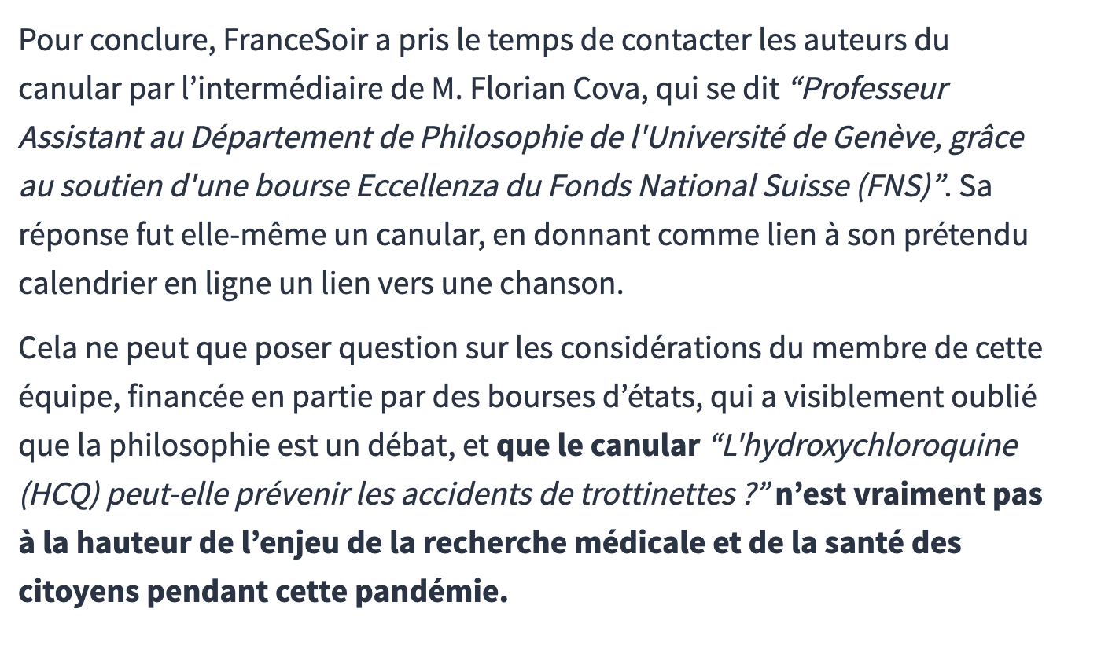
Ca a agacé le blog…

Slide 39
Un député a aussi fondu un fusible pour rien

Slide 40
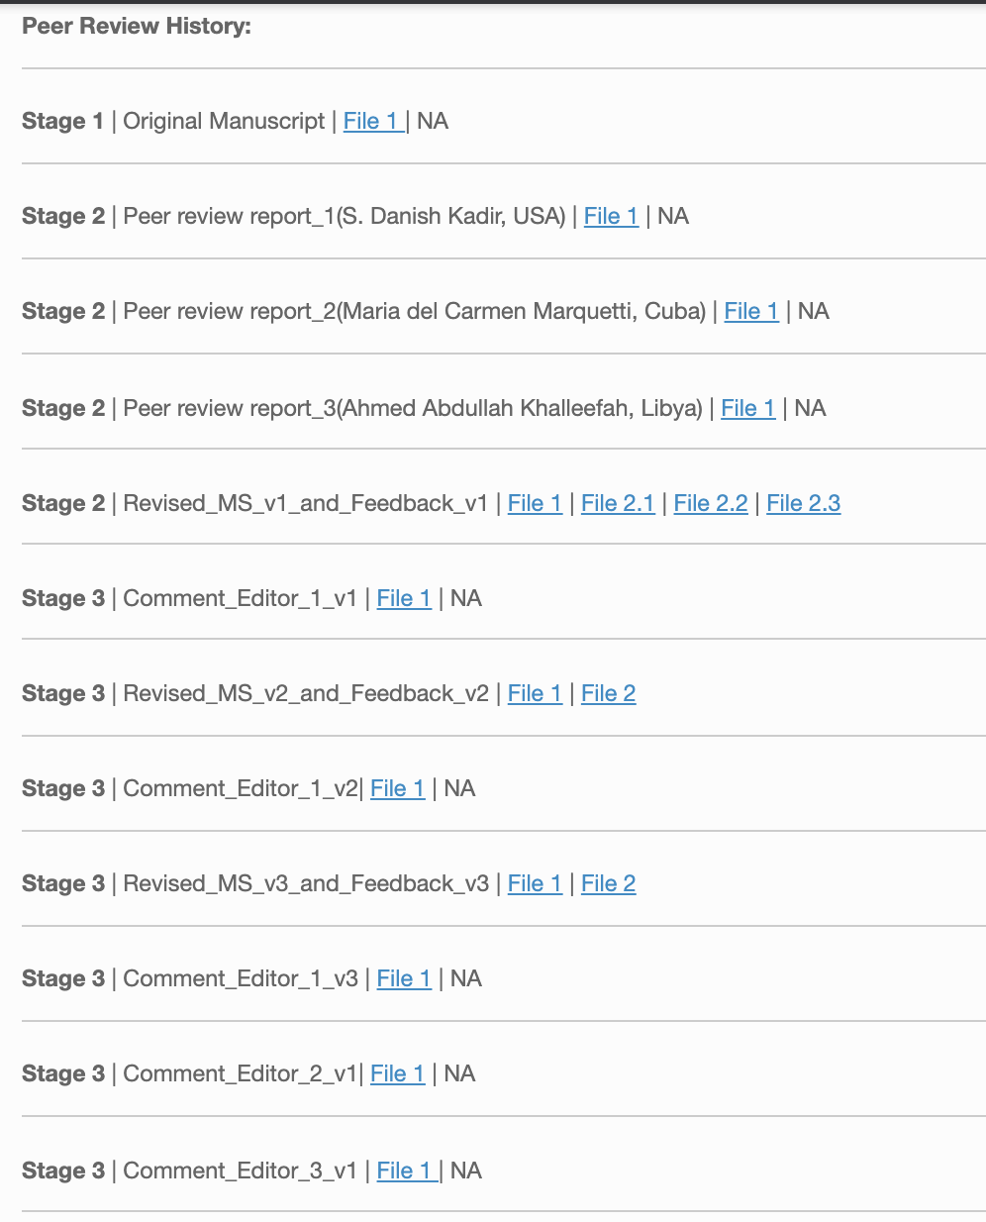
Le peer review en ligne le lundi…

Slide 41
Parce que cet article met la lumière sur les revues prédatrices…

Slide 43
… Bonus track ! Le reviewing du 17 septembre pour une autre revue de Science Domain Int.

Slide 44
La même fiche d’évaluation…

Slide 45
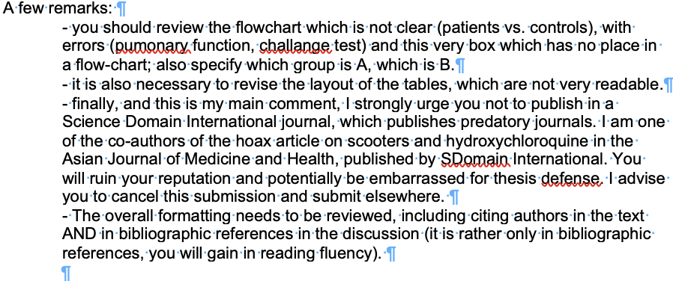
Je dis aux auteurs de fuir…

Slide 46
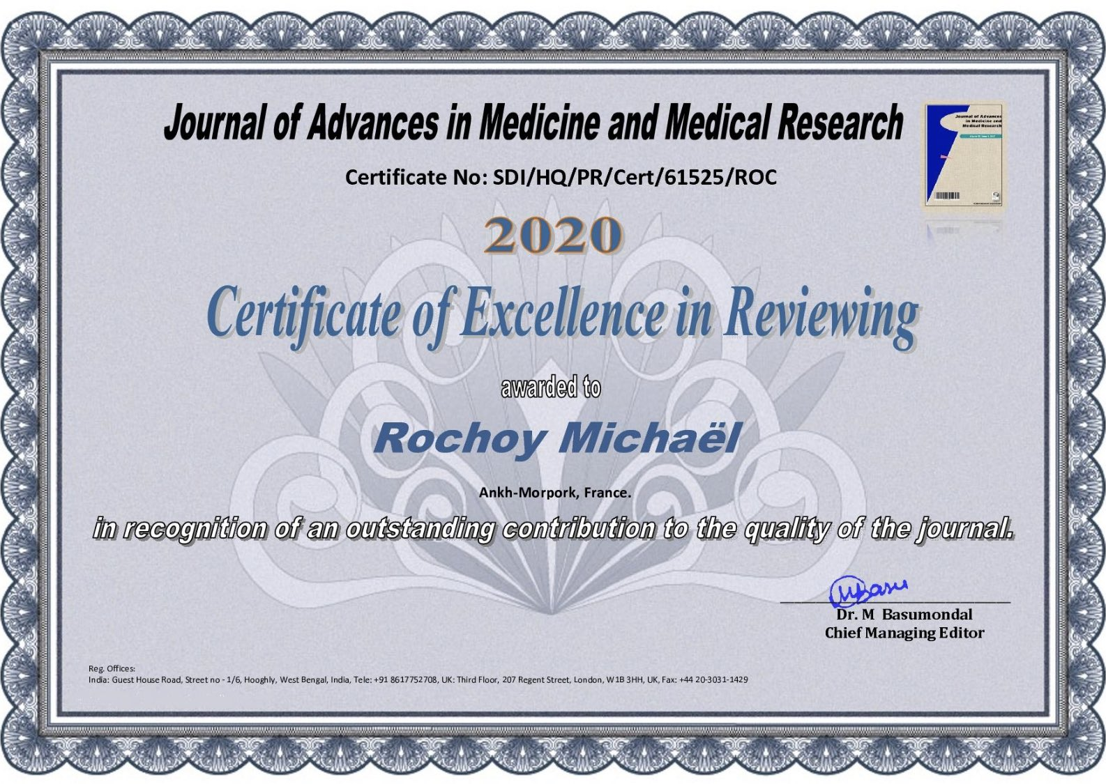
… les éditeurs me remercient pour ma « great contribution » et me remettent un certificat affilié à Ankh-Morpork.

Slide 47
Malgré tout, l’article est publié (j’avais aussi contacté les auteurs sur Facebook)

Slide 48
Et mon reviewing n’apparaît pas (comme notre éditeur n°2)

Slide 49
… Ultime bonus : le livre avorté
Mi-octobre, AJMH a recontacté Mathieu Rebeaud (alias W. Oodendijk) pour en faire un livre (prédateur) contre 80$
Mathieu a accepté, mais le projet n’a pas pu être mené (problème d’éditeur…) et il s’est fait rembourser.

Slide 50
C’était l’occasion…
De remerciements complémentaires : « Thanks to Robin Alais who immediately recognized the scientific importance of our study and roughly translated it into French from day one. Finally, thank you to all those who read our article and often communicated their immense pleasure to us. »
De compléter celle de JSF : « But please don't tell him that this book has been published, otherwise he will complain again about Russia Today France and France Soir, and salt is bad for the crops. »
De corriger les références décalées par l’éditeur (-_-) :
Page 20, la 14 devient 13, la 15 devient 14, etc. La 20 devient 18, la 19 reste 19 et la 20 devait être :
Dusse JC. Strategy and methods: about potential openings with the receptionist. In: Bronze people are skiing. 1979;12(12).
Et d’ajouter nos biographies, à leur demande…

Slide 51
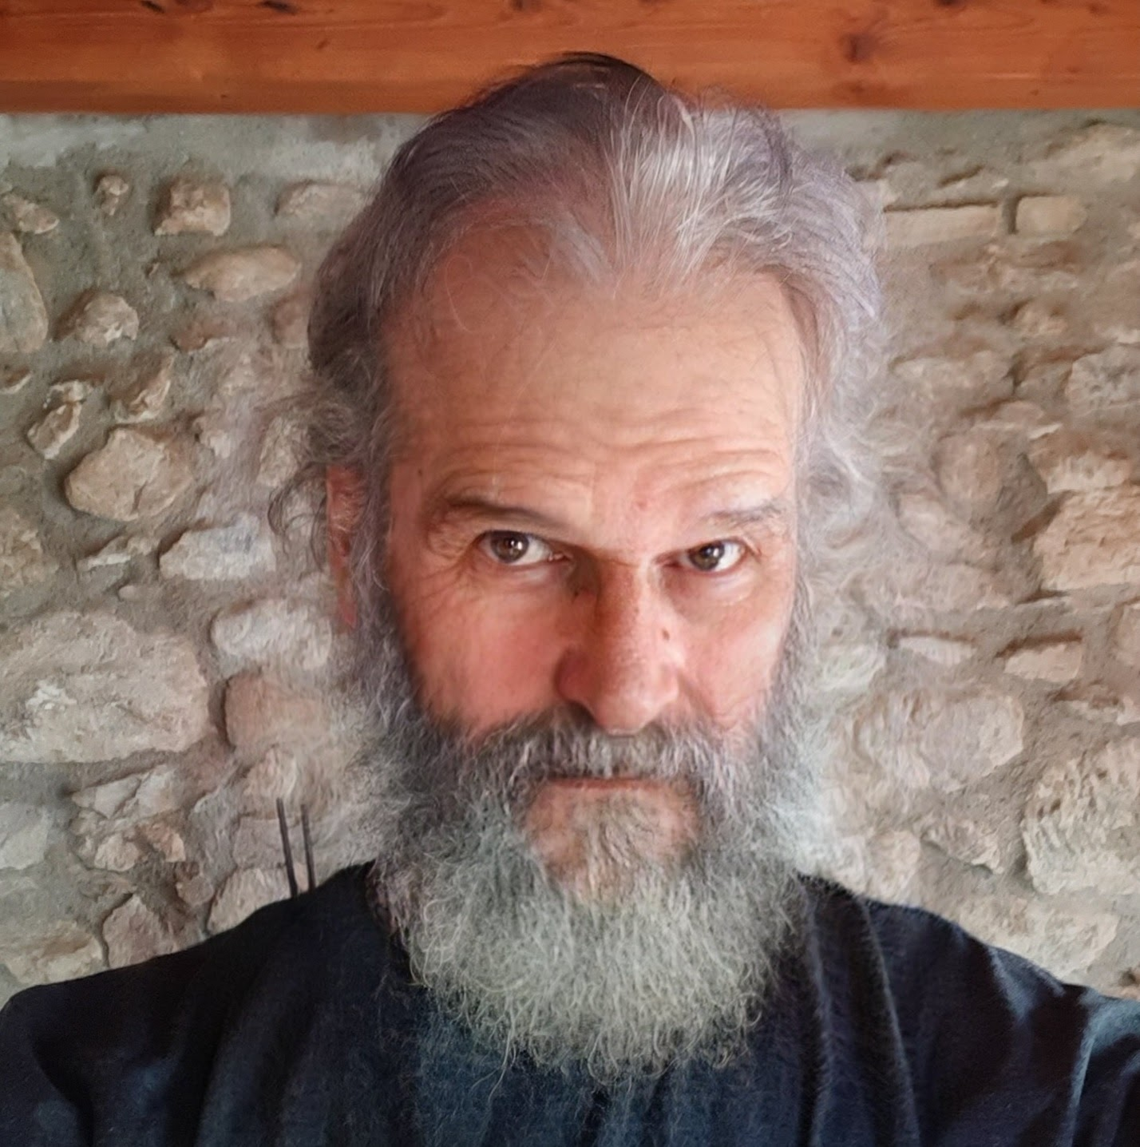
Willard Oodendijk
Dr. Willard Oodendijk, BSc, MSc, FFS, OMG, WTF, MD-PhD is from the well established Belgian Institute of Technology and Education (BITE) in Couillet, Belgium. He first worked in the University of Applied Science of Gland in Switzerland when he studied the relative time of flight of old people when they are hit by very large objects and when they fall suddenly, obtaining a thesis called “Relative Time-of-Flight of eldery: Could a human sized Mass-spectrometer predict how they fall?” with a Magna Cum Laude grade. The Gland university is a famous applied research facility in Switzerland, regrouping three towns: Aubonne-Gimel-Gland, to have more power to work on various subjects. He then proceeded to go to France (in the Hospital of Montcuq) to work on other anti-aging treatments by repurposing Valproate, Mediator, Mibefradil, Fenfluramine and an old stock of suppositories. While being in Montcuq (where there is a very nice bus stop, called “L’arrêt de Montcuq” in French), Willard started to work with some other colleagues from this study, like Dr. Rochoy and Ruggeri. During the COVID-19 pandemic, he worked on push-scooters, old people, hydroxychloroquine and humor. Apart from his work, Oodendijk loves to travel in is native Belgium, especially in Couillet, to see the old Saint-Laurent church, built from the 11th century, that rests on the remains of a Carolingian sanctuary.

Slide 52
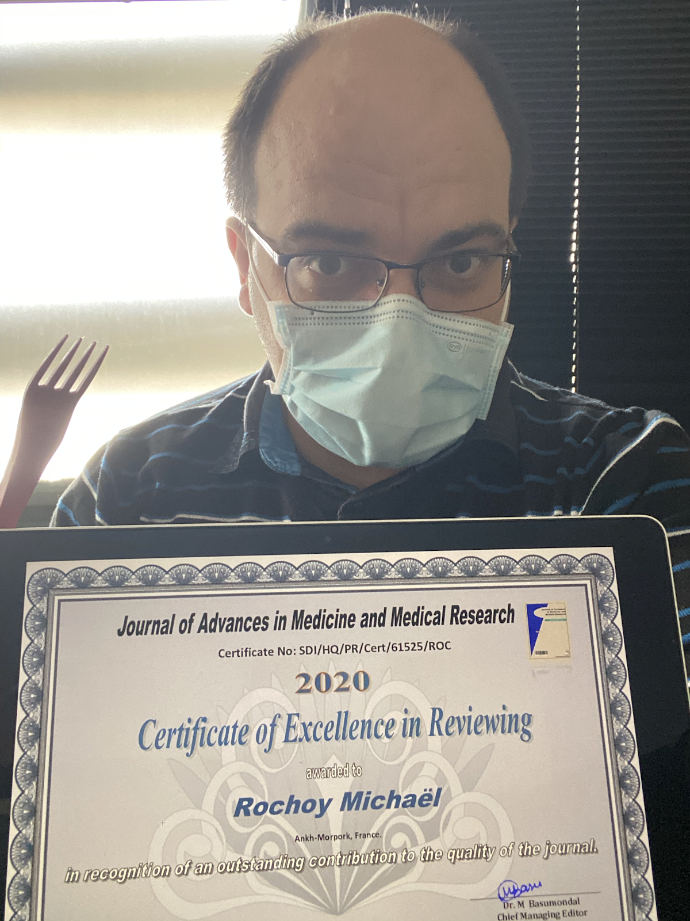
Michaël Rochoy
Dr. Michaël Rochoy is BEPC, BSc, MD, MSc, PhD and one of the two finalists of the “Science in flight” contest in 2003, with a dissertation on the load factor, illustrated by 2 pages of Tintin (Objectif Lune and On a marché sur la Lune). He has always been very successful on the trumpet, which later led him to fight fiercely against the postillons. He discovered gravity thanks to his daughter, who throws everything she finds on the ground; he then warned Newton by building a rustic yet comfortable time machine with its sofa, washing machine and a little pumpkin. His most controversial article, aimed at putting Picsou in the Disney canon, has earned him a lot of lawsuits. Apart from his activity as a general practitioner, he is an independent seeker of science in Ankh-Morpork (France), where he tries to escape from the teams of Moulinsart (the time machine is particularly useful and also leaves a delicate scent of lye and pumpkin on the clothes). His recent discoveries in the field of alopecia make him one of the most important researchers in this discipline; no serious scientific journal has clearly excluded the possibility that he could become a Nobel winner again, which proves that he is the favourite for 2021.

Slide 53
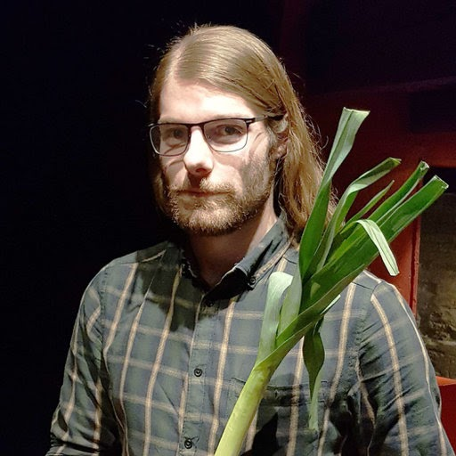
Valentin Ruggeri
After obtaining French nationality and a new identity by integrating the Légion étrangère, Valentin Ruggeri is nowaday DO, DSW, LL.D., with a graduate thesis entitled “Transgressing the Boundaries: Towards a Transformative Hermeneutics of Quantum Gravity”. For an unknown reason, he doesn’t want to say anything about his life before this period. He was recently honored with the medal of the Order of the Leek by the illustrious Pr Canarticho for his useful work in the field of leek alkaloids and their use in veterinary medicine (in particular in ducks and geese farms of Nouvelle Aquitaine, France). During the covid-19 pandemic, he decided to stop all his current research to work on a really useful topic: the role of covid-19 anosmia and ageusia in the decline of tex-mex food sales in France (and a little on push-scooter because his friends ask to him). In addition to his scientific career, he heals people as a physician with natural methods: hœmeopathic remedes, vegetable juice and coffee enema. His motto: “Magnitudinis moli non facit hominem, et altitudo ejus” (Aristoteles the third).

Slide 54
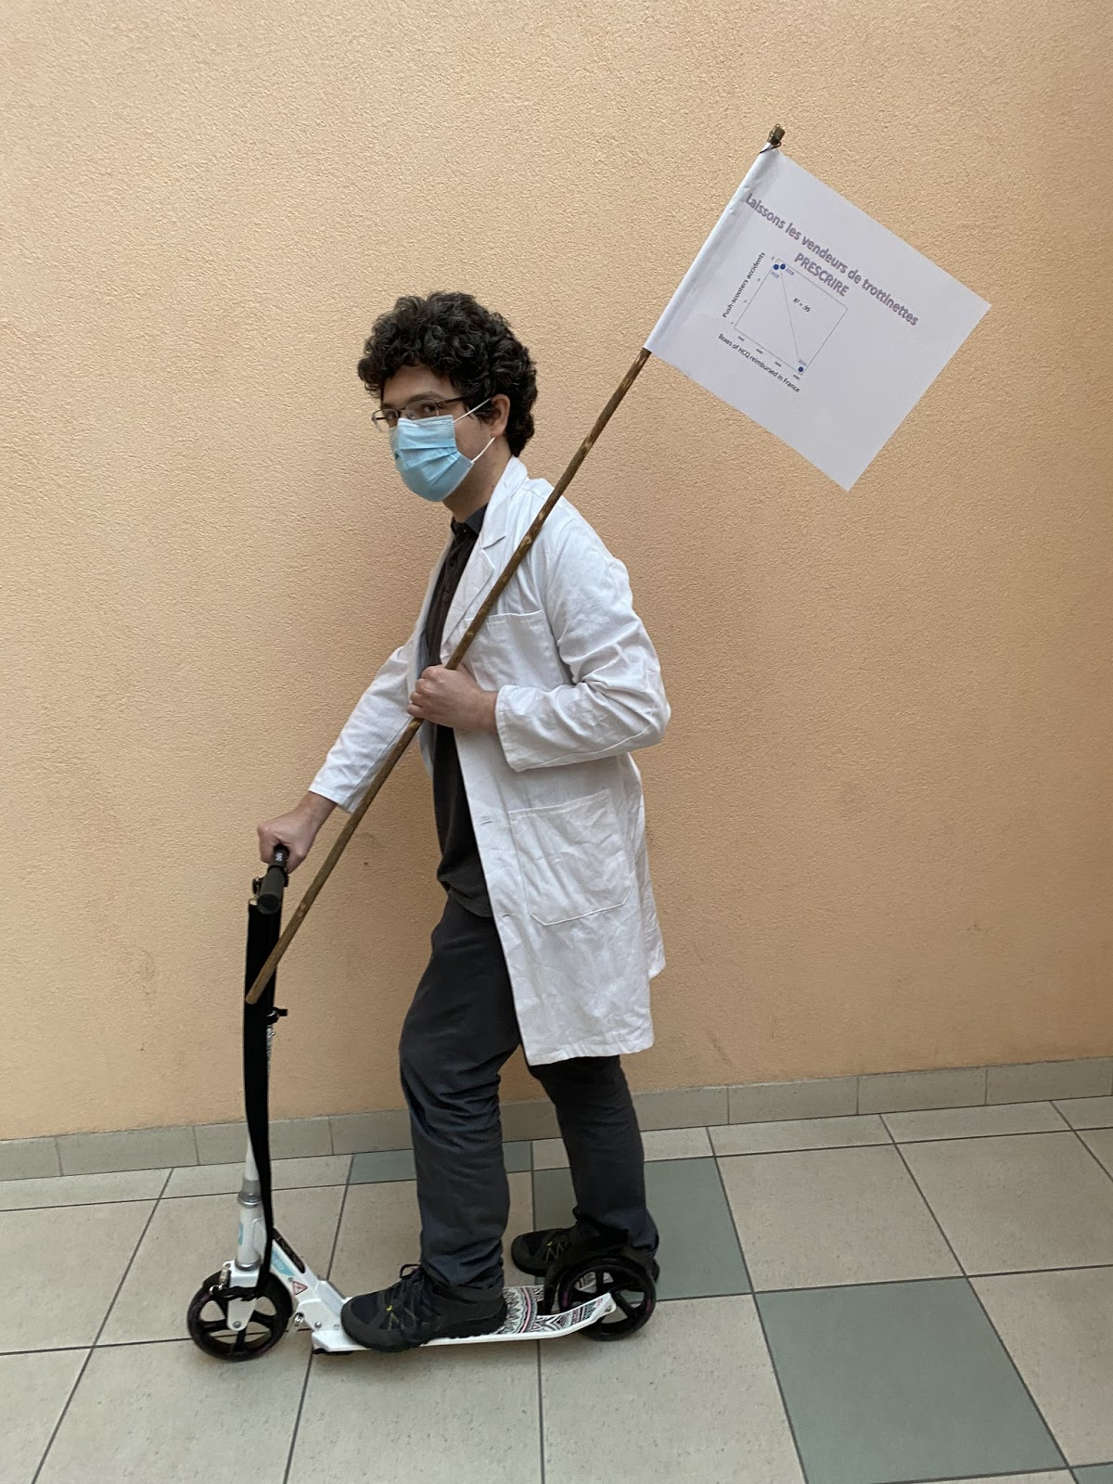
Florian Cova
Florian Cova (PhPhd) is a French polymath whose proficiency in a wide variety of areas (philosophy, psychology, cartomancy, pushscooteromancy, Pokemon tournaments and bullshitology) is well-known. After his formation at the prestigious Cogmaster, where he walked in the footsteps of intellectual giants such as Idriss Aberkane and Joachim Son-Forget, he went to Switzerland to dispense his wisdom to a country that had so far been spared the evils of French “know-it-all intellectuals” (local production, such as J.D. Michel, is irrelevant, as is Swiss wine for the global market). There, he founded the Institute for Quick and Dirty Science in the small town of Neuneuchâtel. Always ready to comment about anything he knows nothing about, he published successful books such as Le retour de la revanche du Pangolin, Covid-19: ce virus qui rend con, Covid-18: The Prequel, and La science est un grand Meuporg. Even though most of his publications are articles in French journals edited by his friends or books accepted by compliant publishers, he sometimes finds the time to publish in obscure international journals, as an intellectual caution for the work of his colleagues. He has a direct connection with the Président de la République, but also with life itself.

Slide 55
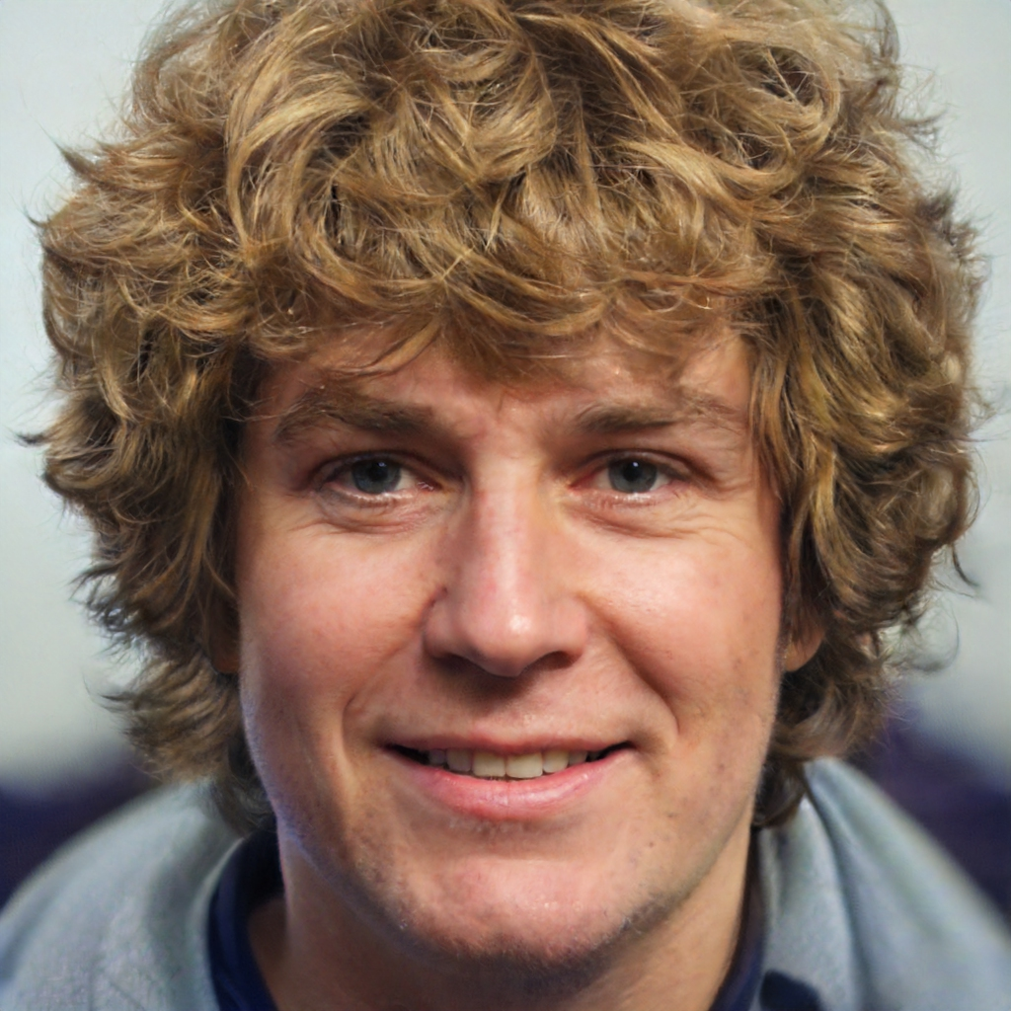
Didier Lembrouille
Didier Lembrouille works in Département de Médecine Nucléaire Compliante de la SFR on the Island of Guyane, off the coast of France, on the oceanic seas. He moved from metropolitan France because of his love of local culture (such as the kwassa-kwassa fishing boats). His beautiful wife and his engineer's salary are only 2 of his 3 main assets. His interest in research dates back to his childhood: at the age of 5, Didier started stuffing animals; his knowledge in taxidermy being as limited as his financial means, the first attempt on a living cat with chair straw was complex (he wouldn't say it was a failure, he would just say that it didn't succeed). He discovered the first 18 COVIDs in the Onfray Laboratory (TPMP University), as well as 16 of the first 18 Parvovirus type B, which enabled him to accede to the coveted position of deputy town councillor in Vigneulles-lès-Hattonchâtel. Having reached this position of responsibility, he quickly developed the sofa promotion — a quite classic young man's life in France. His recent discoveries in the field of COVID-12 (after testing old suppositories on mice) make him one of the most important researchers in this discipline; he keeps his effective treatment to himself to prevent people from buying this currently unmarketed and non-stocked treatment. Above all, he loves logic.

Slide 56
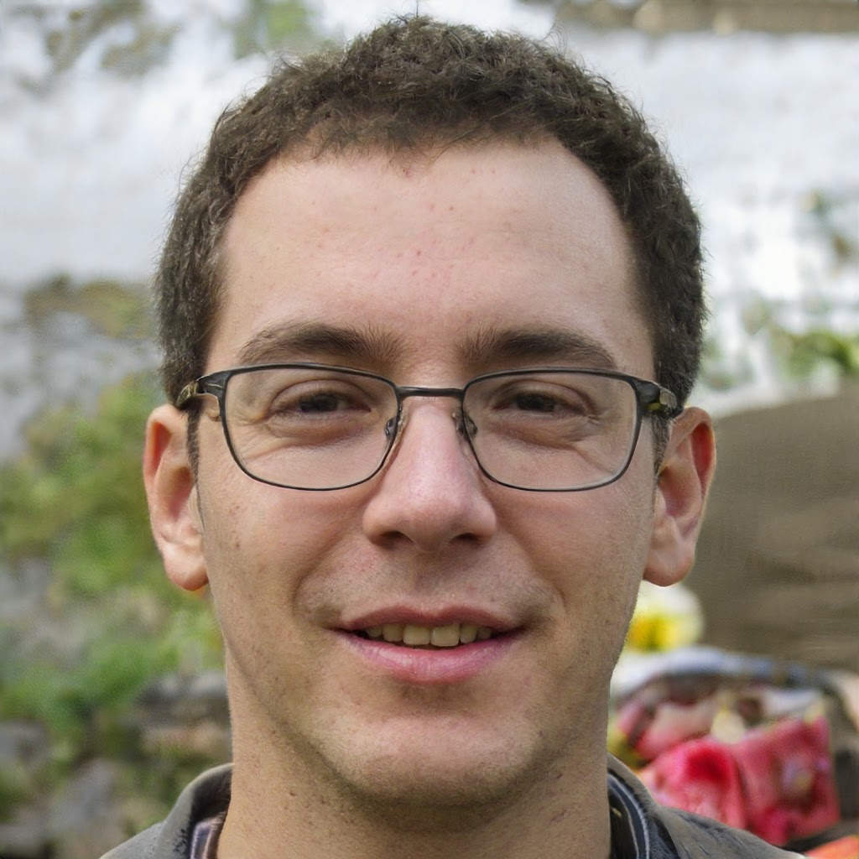
Sylvano Trottinetta
Sylvano Trottinetta is a conspirator who recently launched a for-profit association called WrongSense with a blogger at Rance Poire, Sauron, Voldemort, Max from the Addams Family and some old friends like a Member of Parliament (of the group Predatory Review, Ostracism, Uselessness and Toasts). He worked for 2 weeks in intensive care in 1989 to plug in the coffee machine (the longest being to pass it through the stairs, as it was too wide for the lift), which now allows him to go and explain the current functioning on all TV sets. He recently revealed the conspiracy of GPs and anaesthetist-intensive care physicians in covid pandemy: hundred of them obtained money from the government for inventing fictive cases of covid-19 and for intubating false positive RT-PCR patients without symptoms. As a specialist in emptiness and hollow things, Trottinetta has developed a theory based on the hollow moon, which would be a satellite with an empty core. He has taken accelerated training courses on the all and nothing based on internet 0.2 (it’s like internet 2.0, but in the prehistory). He knows about the new world order, the reptilians and the nazi ticks, but does not yet know what place the Illuminati and the Freemasons will have in all this (this is one of his main lines of research). In order to prevent his brain from being remotely controlled by the 5G contained in the vaccine chip that Bill Gates is going to forcibly inoculate us with via chemtrails, he has decided to part with this dispensable appendix. He divides the scientific community: some believe there is more evidence of intelligent life on Mars than in Sylvano, while others suspect the opposite.

Slide 57
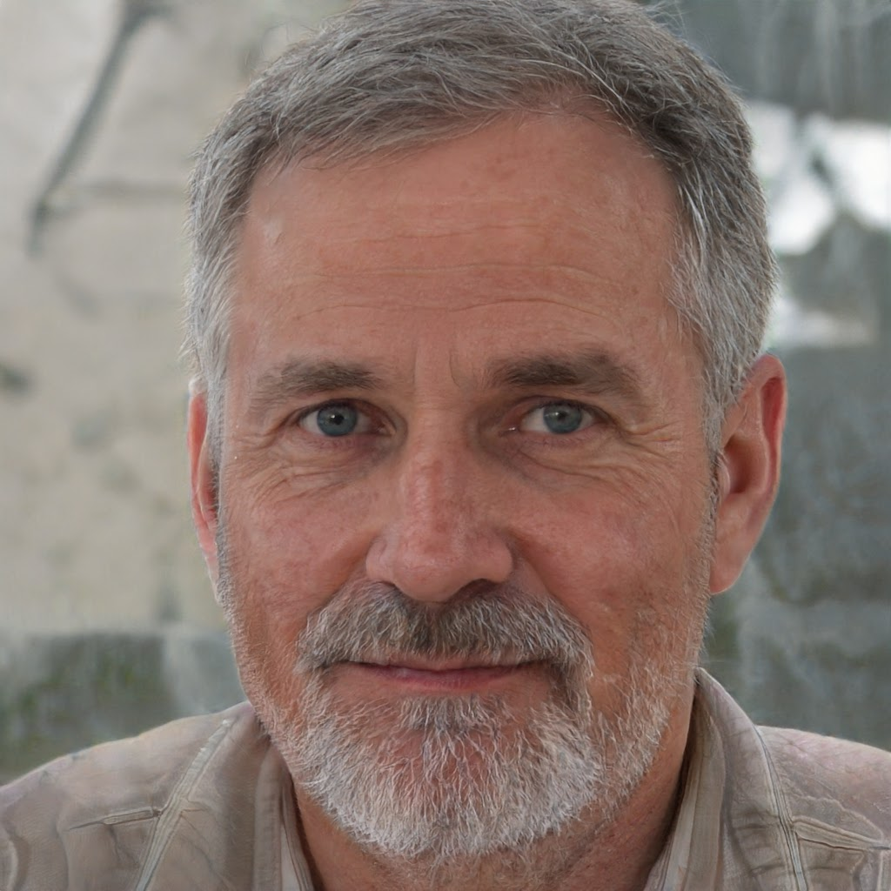
Otter F. Hantome
Pr. Otter F. Hantome, MD-PhD, PhD, PhD, is a vaporous researcher, who spends a great part of his time in television and radio explaining that he does not have time to respond to the media because of his work. He has discovered twelve treatments including hydroxychlorozithromycine (against any disease except pediculosis) and vanilla-strawberry panna cotta (against pediculosis). He knows how to find the good sense of a USB flash drive in less than 3 trials and was the youngest gold medal winner in the competition in 1972. He is chairman of the ethics committee of the University of Melon, perhaps a little rough at times, but knowing how to be very tolerant with his friends — especially those who keep a place for him in their articles. His numerous publications in the parish newsletter of Melon have put him at the top; he is currently testing valentonine and 6-méthoxy-harmalan in elderly patients in an abbey with great success. Together with Paul Lepoulpe, he is considered one of the greatest prophets of our time, if not an oracle: regarding COVID-19, he was wrong only about the epidemic, the pandemic, the route of transmission, the severity, the dynamics, the first wave, the second wave and the treatment. Though these few mistakes (on the part of reality) led him to receive many criticisms from ill-intentioned, jealous people, he does not care because, as a stoic, he only cares about his own self-esteem. Consequently, he does not care either about the fact that stoics never said such a thing.

Slide 58
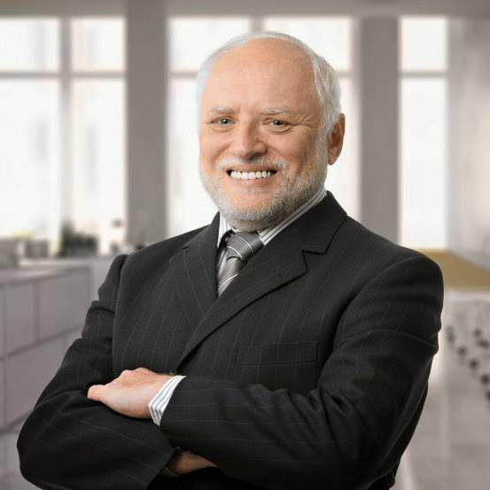
Nemo Macron
Nemo Macron didn't want to transmit a personal photo because he is too shy, so he sent us a photo of Harold instead. Yet his contribution to science is internationally recognized: when doubt creeps into research, he is often there to say “wouf” and allow researchers to believe in them; it is important, especially when preparing a thesis, because there are always moments of doubt, moments when the director is playing dead, drowning in his emails; there are corrections that one would not want to make, and then these hours of doubt, these questions: what's the point? One "woof" and all that disappears. He lives at the Elysée Palazzo, France, where he is the only but most famous scientist: not only does he aerate his kennel for 5 minutes every half hour because he understood the aerosolization risk, but also he used to promote the mask for children and telework when other members of his laboratory continued to visit tomato greenhouses without masks. Of course, you have to admit that tomatoes are not his favourite dish.

Slide 59
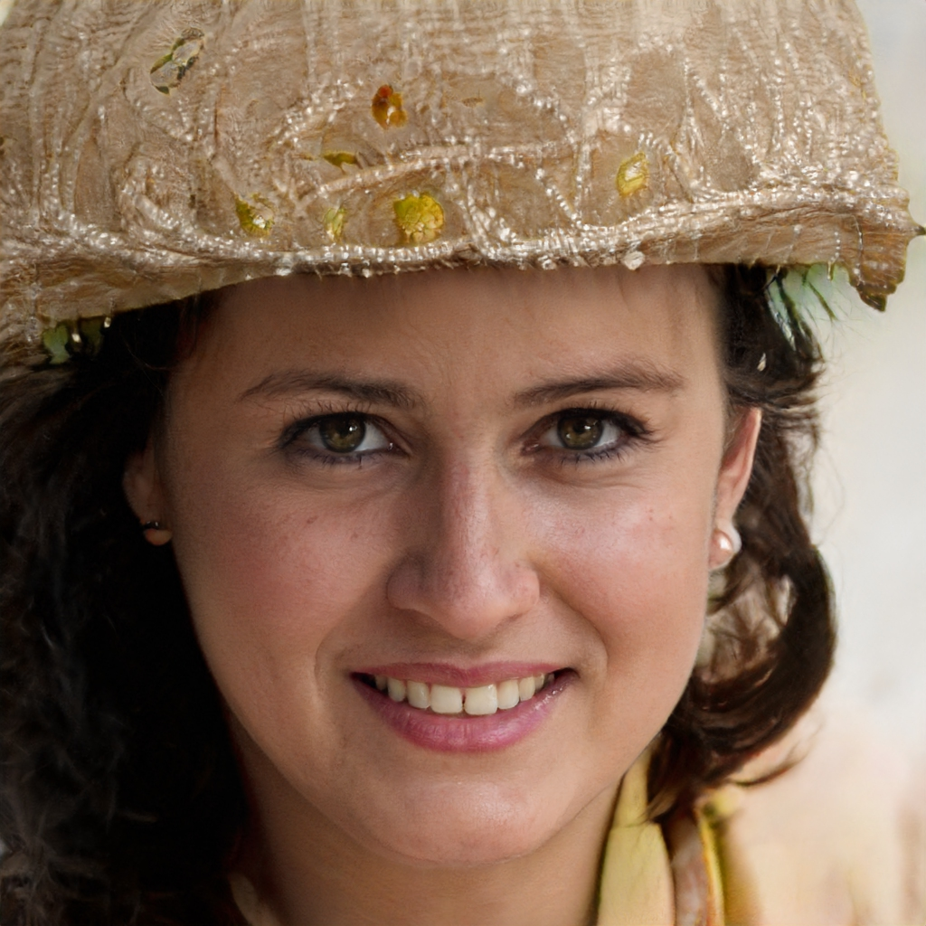
Manis Javanica
Manis Javanica, P.Ang.OL.In., despite modest origins, is a person of great talent who succeeded to get a scholarship and thus went to study in Seoul (North Korea). She was the first of the family to go to university for studying (her uncle was once in an university but by accident: he was searching for a pizzeria). After her doctorate in advanced technology of animal studies, she decided to realize her dream to study biology not in an office but in the green underworld of the Indonesian wild forests. She survived malaria and cannibals for the glory of science, and discovered seven new species of Chiroptera, including one who eats blood, which is her biggest finding. She studied the behavior of this particular species for one entire year in the jungle without any human contact, and thus wrote several excellent papers in different journals and a book about the benefits of loneliness on agoraphobia and misanthropia. She did not really participate in this article, but made by mistake a comment on Linkedin and said that “the last place would be good enough for him”; the authors thought she was a man, before receiving the photo for this book.

Slide 60
Je vous remercie pour votre attention michael.rochoy@gmail.com http://www.mimiryudo.com/blog/2020/08/le-meilleur-article-de-tous-les-temps/

Slide 61
Questions (Delphine, Damien)
J'aimerais bien savoir à combien de revues ils ont proposé leur article avant d'être publiés. ➔ 1
S'ils avaient choisi cette revue là en particulier, pourquoi? ➔ Guérin, Wonner
S'ils ont dû payer pour publier dans cette revue. ➔ 77€
Quel a été l'impact de cette publication dans le milieu anglophone (vu qu'apparemment ça a été publié en anglais au départ)? ➔ Poilade internationale.
Quel impact dans le milieu de la recherche? Les revues sans reviewers ont-elles moins la cote? ➔ j’en doute…
Qu'est-ce qui est vrai dans leur article? ➔ le remerciement à Hervé Maisonneuve
En fallait-il un minimum pour que l'article soit publié? ➔ je ne pense pas ^^
Et François (mon mari) me suggère de lui demander comment il vit le harcèlement des pro-Raoult depuis la sortie de leur article. ➔ l’humour ça passe bien : quasi 0 harcèlement (RT France et France Soir pas content, JSF en colère pour rien, un appel de Marseillais qui me traite d’imbécile et me met un 0 étoile sur Google :D)
Une question peut-être sur la procédure de reviewing. Pourrait-on avoir un aperçu des allers retours avec le journal? Ca rajouterait au cocasse! ➔ fait !

